Slide 1
Neural Networks -II
Mihir Mohite
Jeet Kulkarni
Rituparna Bhise
Shrinand Javadekar
Data Mining CSE 634
Prof. Anita Wasilewska

Slide 2
References
http://www.csse.uwa.edu.au/teaching/units/233.407/lecture
Notes/Lect4-UWA.pdf
http://www.csse.uwa.edu.au/teaching/units/233.407/lecture
Notes/Lect4-UWA.pdf
http://www.comp.glam.ac.uk/digimaging/neural.htm
http://www.nbb.cornell.edu/neurobio/linster/lecture4.pdf
src:http://www.nbb.cornell.edu/neurobio/linster/lecture4.pdf
Lecture slides prepared by Jalal Mahmud and Hyung-Yeon Gu
under the guidance of Prof. Anita Wasilewska

Slide 3
Basics of a Neural Network
Neural Network is a set of connected
INPUT/OUTPUT UNITS, where each connection has a WEIGHT associated with it
Neural Network learns by adjusting the weights so as to be able to correctly classify the training data and hence, after testing phase, to classify unknown data.

Slide 4
Basics of a Neural Network
Input: Classification data
It contains classification attribute
Data is divided, as in any classification problem.
[Training data and Testing data]
All data must be normalized
(i.e. all values of attributes in the database are changed to contain values in the internal [0,1] or[-1,1])
Neural Network can work with data in the range of (0,1) or (-1,1)

Slide 5
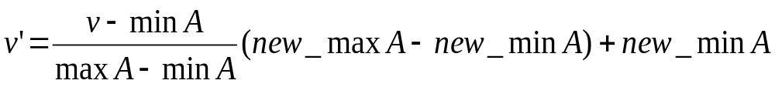
Basics of a Neural Network
Example: We want to normalize data to range of the interval [0,1].
We put: new_max A= 1, new_minA =0.
Say, max A was 100 and min A was 20 ( That means maximum and minimum values for the attribute ).
Now, if v = 40 ( If for this particular pattern , attribute value is 40 ), v’ will be calculated as , v’ = (40-20) x (1-0) / (100-20) + 0
=> v’ = 20 x 1/80
=> v’ = 0.4

Slide 6
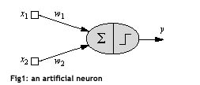
A single Neuron
Here x1 and x2 are normalized attribute value of data.
y is the output of the neuron , i.e the class label.
x1 and x2 values multiplied by weight values w1 and w2 are input to the neuron x.
Value of x1 is multiplied by a weight w1 and values of x2 is multiplied by a weight w2.

Slide 7
A single Neuron
Given that
  w1 = 0.5 and w2 = 0.5
  Say value of x1 is 0.3 and value of x2 is 0.8,
  So, weighted sum is :
  sum= w1 x x1 + w2 x x2 = 0.5 x 0.3 + 0.5 x 0.8 = 0.55

Slide 8
A single Neuron
  The neuron receives the weighted sum as input and calculates the output as a function of input as follows :
  y = f(x) , where f(x) is defined as
  f(x) = 0 { when x< 0.5 }
  f(x) = 1 { when x >= 0.5 }
  For our example, x ( weighted sum ) is 0.55, so y = 1 ,
  That means corresponding input attribute values are classified in class 1.
  If for another input values , x = 0.45 , then f(x) = 0,
  so we could conclude that input values are classified to class 0.

Slide 9
Bias of a Neuron
We need the bias value to be added to the weighted sum ∑w_{i}x_{i} so that we can transform it from the origin.
x1-x2= -1
x2
x1-x2=0
x1-x2= 1
x1

Slide 10
Bias as an input
X0= +1
w0
o/p class
w1
∑
x1
f
wn
Activation func
xn
Summing func

Slide 11
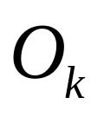

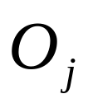
A Multilayer Feed-Forward Neural Network
Output Class
Output nodes
Hidden nodes
w_{ij}
- weights
Input nodes
Network is fully connected
Input Record : x_{i}

Slide 12
Inputs to a Neural Network
INPUT: records without class attribute with normalized attributes values.
INPUT VECTOR: X = { x1, x2, …. xn}
where n is the number of (non class) attributes.
WEIGHT VECTOR: W = {w1,w2,….wn} where n is the number of (non-class) attributes
INPUT LAYER – there are as many nodes as non-class attributes i.e. as the length of the input vector.
HIDDEN LAYER – the number of nodes in the hidden layer and the number of hidden layers depends on implementation.

Slide 13
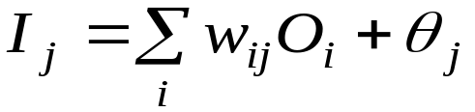

Net Weighted Input
Given a unit j in a hidden or output layer, the net input is
where wij is the weight of the connection from unit i in the previous layer to unit j; Oi is the output of unit I from the previous layer;
is the bias of the unit

Slide 14
Binary activation function
Given a net input Ij to unit j, then
Oj = f(Ij),
the output of unit j, is computed as
Oj = 1 if lj>T
Oj= 0 if lj<=T
Where T is known as the Threshold

Slide 15
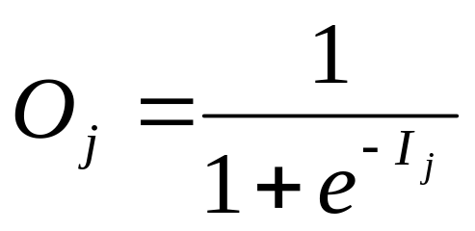
Squashing activation function
Each unit in the hidden and output layers takes its net input and then applies an activation function. The function symbolizes the activation of the neuron represented by the unit. It is also called a logistic, sigmoid, or squashing function.
Given a net input Ij to unit j, then
Oj = f(Ij),
the output of unit j, is computed as

Slide 16
Learning in Neural Networks
Learning in Neural Networks-what is it?
Why is learning required?
Supervised and Unsupervised learning
It takes a long time to train a neural network
A well trained network is tolerant to noise in data

Slide 17
Using Error Correction
  Used for supervised learning
Perceptron Learning Formula
  For binary-valued response function
Delta Learning Formula
  For continuous-valued response function

Slide 18
Using Error Correction
Perceptron Learning Formula
  ∆w_{i} = c[d_{i} –o_{i}]x_{i}
  So the value of ∆w_{i} is either
  0 (when expected output and actual output are the same)
  Or
  2cx_{i} (when d_{i} –o_{i} is +/-2)

Slide 19
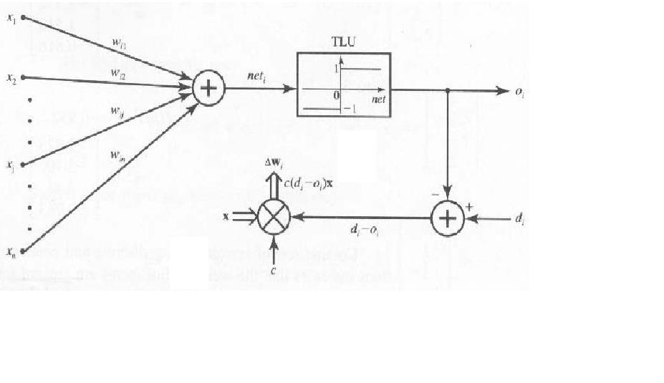
Using Error Correction
Perceptron Learning Formula
(http://www.csse.uwa.edu.au/teaching/units/233.407/lectureNotes/Lect4-UWA.pdf)

Slide 20
Using Error Correction
Delta Learning Formula
  ∆w_{i} = c[d_{i} –o_{i}]x_{i} * o’_{i}
  In case of a unipolar squashing activation function the value of o’_{i} evaluates to o_{i}(1- o_{i}).
  Where o_{i} is given as o_{i} = 1/(1 + e^{-net i/p} )

Slide 21
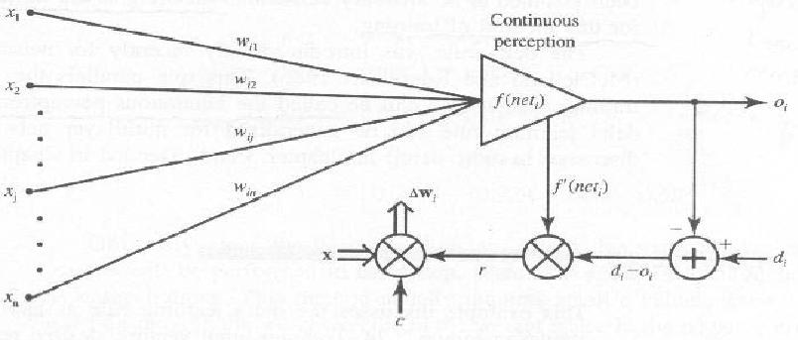
Using Error Correction
Delta Learning Formula
(http://www.csse.uwa.edu.au/teaching/units/233.407/lectureNotes/Lect4-UWA.pdf)

Slide 22
Hebbian Learning Formula
A purely feed forward unsupervised learning network
Hebbian learning formula comes from Hebb’s postulation that if two neurones were very active at the same time which is illustrated by the high values of both its output and one of its inputs, the strength of the connection between the two neurones will grow or increase.
Depends on pre-synaptic and post-synaptic activities
src:http://www.comp.glam.ac.uk/digimaging/neural.htm

Slide 23
Hebbian Learning Formula
If xj is the output of the presynaptic neuron, xi the output of the postsynaptic neuron, and wij the strength of the connection between them, and γ learning rate, then one form of a learning formula would be:
∆Wij (t) = γ∗xj*xi
src:http://www.nbb.cornell.edu/neurobio/linster/lecture4.pdf

Slide 24
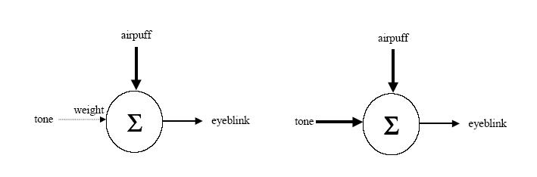
Hebbian Learning Formula
src:http://www.nbb.cornell.edu/neurobio/linster/lecture4.pdf

Slide 25
Competitive Learning
Unsupervised network training, and applicable for an ensemble of neurons (e.g. a layer of p neurons), not for a single neuron.
Output neurons of NN compete to become active
Adapt the neuron m which has the maximum response due to input x
Only single neuron is active at any one time
  –salient feature for pattern classification
  –Neurons learn to specialize on ensembles of similar patterns; Therefore,
  –They become feature detectors

Slide 26
Competitive Learning
Basic Elements
  A set of neurons that are all same except synaptic weight distribution
    respond differently to a given set of input pattern
    A mechanism to compete to respond to a given input
    The winner that wins the competition is called“winner-takes-all”

Slide 27
Competitive Learning
For example, if the input vector is (0.35, 0.8), the winning neurode might have weight vector (0.4, 0.78). The learning rule would adjust the weight vector to make it even closer to the input vector. Only the winning neurode produces output, and only the winning neurode gets its weights adjusted.

Slide 28
References
http://www.csse.uwa.edu.au/teaching/units/233.407/lectureNotes/Lect4-UWA
Eric Plummer, University of Wyoming www.karlbranting.net/papers/plummer/Pres.ppt
J.M. Zurada, “Introduction to Artificial Neural Systems”, West Publishing Company, 1992, chapter 3.

Slide 29
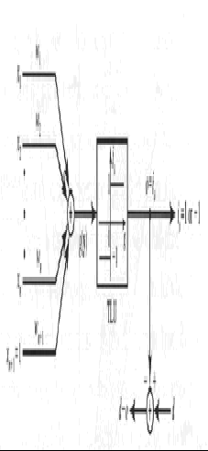
The Discrete Perceptron
Src: http://www.csse.uwa.edu.au/teaching/units/233.407/lectureNotes/Lect4-UWA

Slide 30
Single Discrete Perceptron Training Algorithm (SDPTA)
We will begin to examine neural network classifiers that derive their weights during the learning cycle.
The sample pattern vectors X₁, X₂, …, X_{p}, called the training sequence, are presented to the machine along with the correct response.
Based on the perceptron learning rule seen earlier.

Slide 31
Given are P training pairs
{X₁,d₁,X₂,d₂....X_{p},d_{p}}, where
X_{i} is (n*1)
d_{i} is (1*1)
i=1,2,...P
Y_{i=} Augmented input pattern( obtained by appending 1 to the input vector)
i=1,2,…P
In the following, k denotes the training step and p denotes the step counter within the training cycle
Step 1: c>0 is chosen.
Step 2: Weights are initialized at w at small values, w is (n+1)*1. Counters and error are initialized.
k=1,p=1,E=0
Step 3: The training cycle begins here. Input is presented and output computed:
Y=Y_{p}, d=d_{p}
O=sgn(w^{t}Y)

Slide 32
SDPTA contd..
Step 4: Weights are updated:
W=W+1/2c(d-o)Y
Step 5: Cycle error is computed:
E=1/2(d-o)²+E
Step 6: If p<P then p=p+1,k=k+1, and go to Step 3:
Otherwise go to Step 7.
Step 7: The training cycle is completed. For E=0,terminate the training session. Outputs weights and k.
If E>0,then E=0 ,p=1, and enter the new training cycle by going to step 3.

Slide 33
Single Continous Perceptron Training Algorithm (SCPTA)
We will begin to examine neural network classifiers that derive their weights during the learning cycle.
The sample pattern vectors X₁, X₂, …, X_{p}, called the training sequence, are presented to the machine along with the correct response.
Based on the delta learning rule seen earlier.

Slide 34
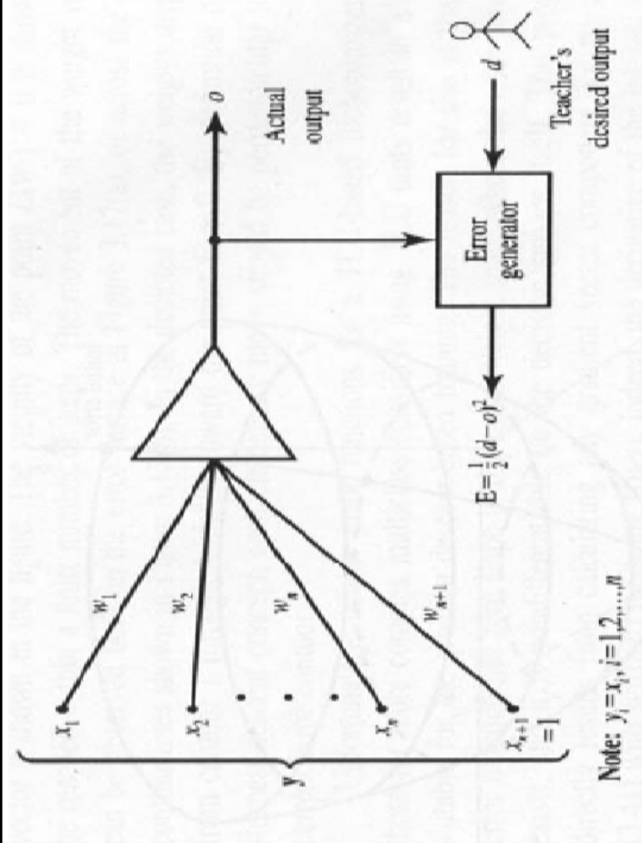
The Continuous Perceptron
Src: http://www.csse.uwa.edu.au/teaching/units/233.407/lectureNotes/Lect4-UWA

Slide 35
Given are P training pairs
{X₁,d₁,X₂,d₂....X_{p},d_{p}}, where
X_{i} is (n*1)
d_{i} is (1*1)
i=1,2,...P
Y_{i=} Augmented input pattern( obtained by appending 1 to the input vector)
i=1,2,…P
In the following, k denotes the training step and p denotes the step counter within the training cycle
Step 1: c>0 , E_{min} is chosen,
Step 2: Weights are initialized at w at small values, w is (n+1)*1. Counters and error are initialized.
k=1,p=1,E=0
Step 3: The training cycle begins here. Input is presented and output computed:
Y=Yp, d=d_{p}
O=f(net) net=w^{t}Y.

Slide 36
SCPTA contd..
Step 4: Weights are updated:
W=W+1/2c(d-o)(1-o²)Y
Step 5: Cycle error is computed:
E=1/2(d-o)²+E
Step 6: If p<P then p=p+1,k=k+1, and go to Step 3:
Otherwise go to Step 7.
Step 7: The training cycle is completed. For E< E_{min},terminate the training session. Outputs weights and k.
If E>0,then E=0 ,p=1, and enter the new training cycle by going to step 3.

Slide 37
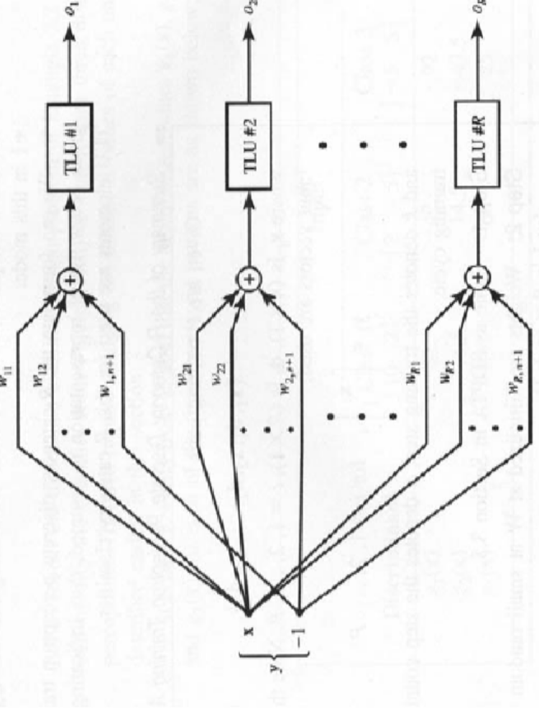
R category Discrete Perceptron Training Algorithm (RDPTA)
Src: http://www.csse.uwa.edu.au/teaching/units/233.407/lectureNotes/Lect4-UWA

Slide 38
Algorithm
Given are P training pairs
{X₁,d₁,X₂,d₂....X_{p},d_{p}}, where
X_{i} is (n*1)
d_{i} is (n*1)
No of Categories=R.
i=1,2,...P
Y_{i=} Augmented input pattern( obtained by appending 1 to the input vector)
i=1,2,…P
In the following, k denotes the training step and p denotes the step counter within the training cycle
Step 1: c>0 , E_{min} is chosen,
Step 2: Weights are initialized at w at small values, w is (n+1)*1. Counters and error are initialized.
k=1,p=1,E=0
Step 3: The training cycle begins here. Input is presented and output computed:
Y=Yp, d=d_{p}
O_{i}=f(w^{t}Y) for i=1,2,….R

Slide 39
RDPTA contd..
Step 4: Weights are updated:
w_{i}=w_{i}+1/2c(d_{i}-o_{i})Y for i=1,2,…..R.
Step 5: Cycle error is computed:
E=1/2(d_{i}-o_{i})²+E for i=1,2,…..R.
Step 6: If p<P then p=p+1,k=k+1, and go to Step 3:
Otherwise go to Step 7.
Step 7: The training cycle is completed. For E=0,terminate the training session. Outputs weights and k.
If E>0,then E=0 ,p=1, and enter the new training cycle by going to step 3.

Slide 40
What is Backpropagation?
Supervised Error Back-propagation Training
The mechanism of backward error transmission is used to modify the synaptic weights of the internal (hidden) and output layers.
Based on the delta learning rule.
• One of the most popular algorithms for supervised training of multilayer feed forward networks.

Slide 41
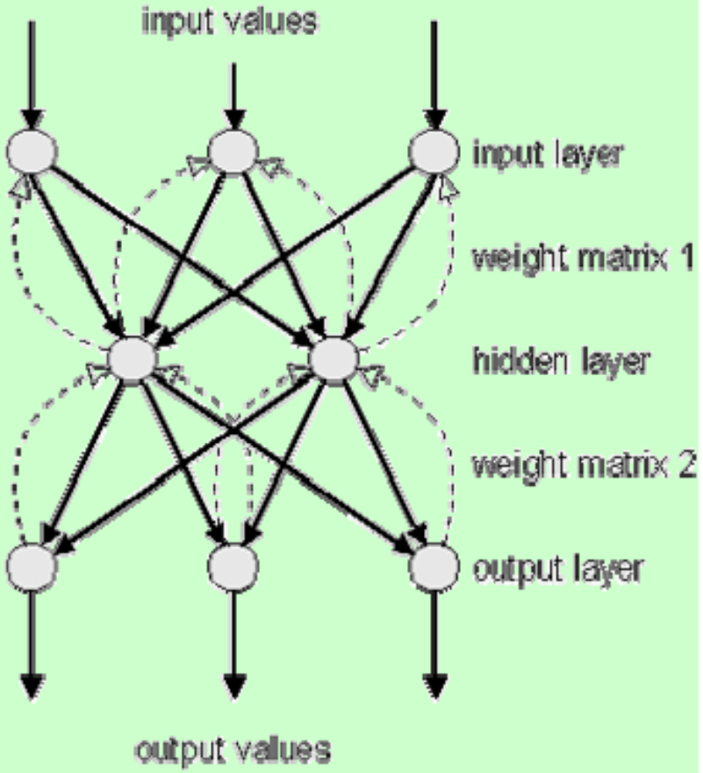
Architecture: Backpropagation Network
The Backpropagation Net was first introduced by G.E. Hinton, E. Rumelhart and R.J. Williams in 1986.
Type:
Feedforward
Neuron layers:
1 input layer
1 or more hidden layers
1 output layer
Learning Method:
Supervised

Slide 42
Notation:
x = input training vector
t = Output target vector.
δ_{k} = portion of error correction weight for wjk that is due
to an error at output unit Y_{k}; also the information about
the error at unit Y_{k} that is propagated back to the hidden
units that feed into unit Y_{k}
δ_{j} = portion of error correction weight for v_{jk} that is due to
the backpropagation of error information from the output
layer to the hidden unit Z_{j}
α = learning rate.
v_{oj} = bias on hidden unit j
w_{ok} = bias on output unit k

Slide 43
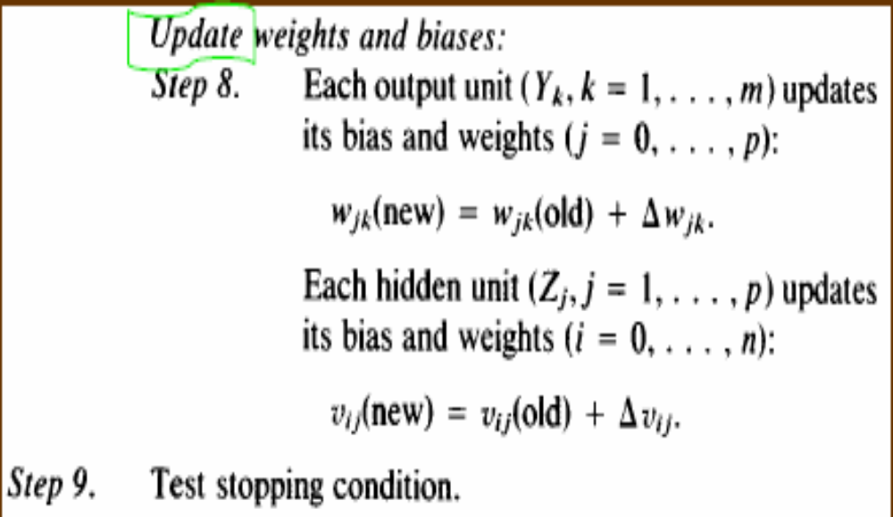
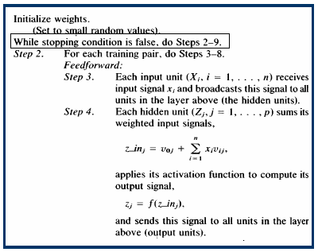
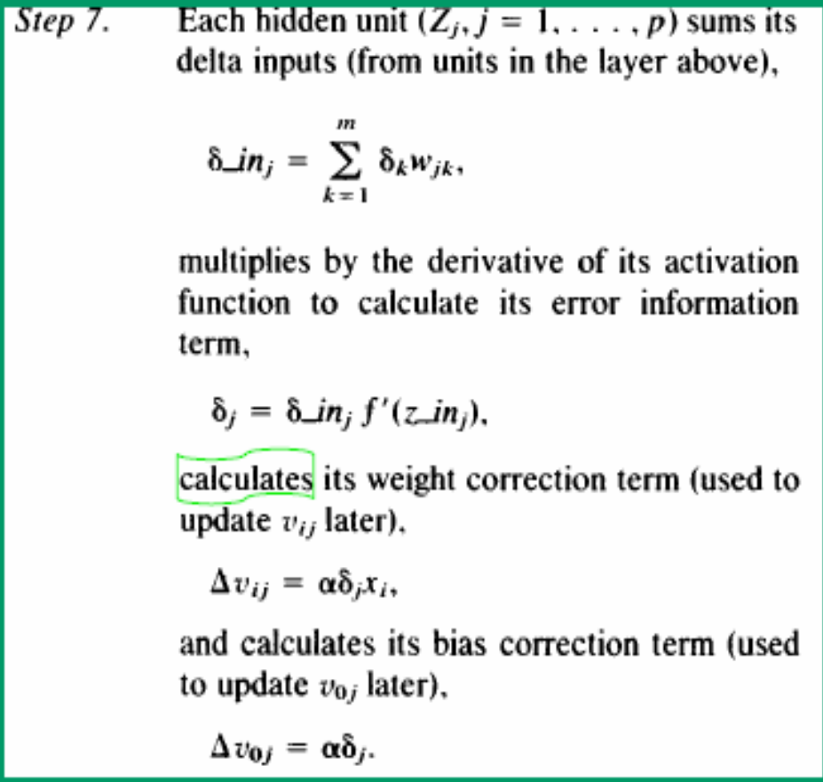
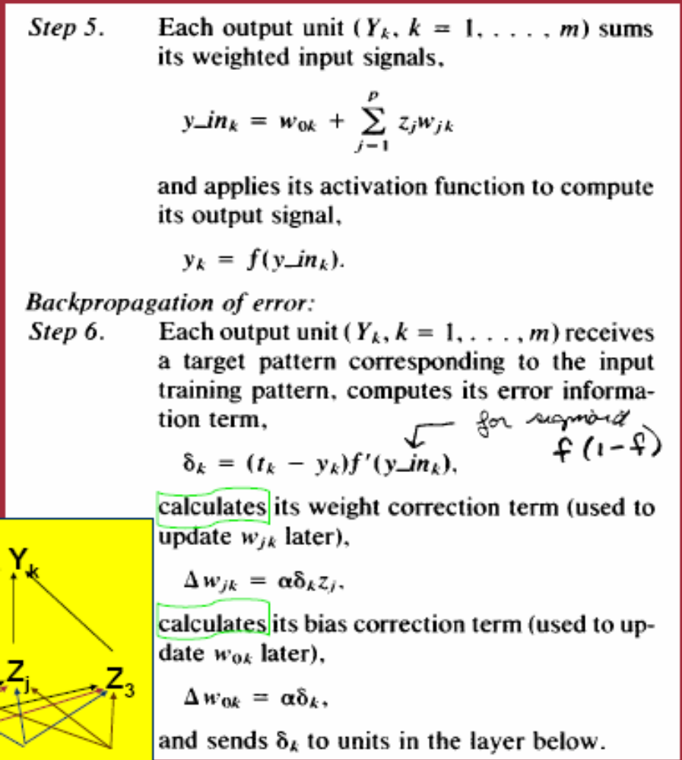
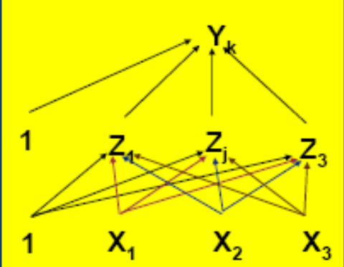
EBPTA contd..

Slide 44
Generalisation
Once trained, weights are held constant, and input patterns are applied in feedforward.
mode. - Commonly called “recall mode”.
We wish network to “generalize”, i.e. to make sensible choices about input vectors which are not in the training set.
Commonly we check generalization of a
network by dividing known patterns into a
training set, used to adjust weights, and a test set, used to evaluate performance of trained network.

Slide 45
Generalisation …
Generalisation can be improved by
– Using a smaller number of hidden units
(network must learn the rule, not just the
examples)
– Not overtraining (occasionally check that
error on test set is not increasing)
– Ensuring training set includes a good
mixture of examples
No good rule for deciding upon good network size (#
of layers, # units per layer)

Slide 46
Handwritten Text Recognition
References
1)A Neural Based Segmentation and Recognition Technique for Handwritten Words - M. Blumenstein and B. Verma, School of Information Technology, Griffith University, Gold Coast Campus, Qld 9726, Australia.
IEEE World Congress on Computational Intelligence. The 1998 IEEE International Joint Conference , Neural Networks Proceedings, 9th May 1998.
2)An Off-Line Cursive Handwriting Recognition System- Andrew W. Senior,Anthony J. Robinson,IEEE Transactions on Pattern Analysis and Machine Intelligence, vol. 20, 1998
3) http://www.codeproject.com/dotnet/simple_ocr.asp

Slide 47
Steps for Classification
Binarisation
Preprocessing
Segmentation using
heuristic algorithm
Training of
Segmentation ANN
Segmentation Validation
using ANN
Training of Character
Recognizing ANN
Extraction of
individual words

Slide 48
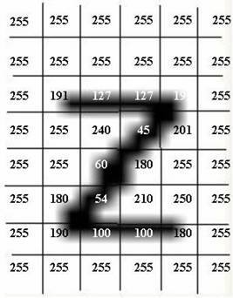
Input Representation
The image is split into squares and we calculate average value of each square. Thus, the input is digitized and stored into a data structure like an array.
Digitized input representation
** source http://www.codeproject.com/dotnet/simple_ocr.asp

Slide 49

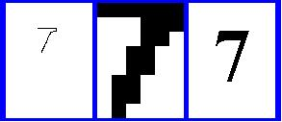

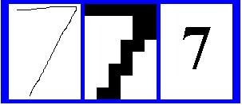
Preprocessing
Slope Correction
Slant Correction
Size is normalized
Neural Network
**Screenshots taken from: http://www.thomastannahill.com/tom-ato/
Notes:
The slant of a word is estimated by finding the average angle of near-vertical strokes. (edge detection filter)

Slide 50


Segmentation using ANN
Train ANN with
segmentation points
n - inputs
1 - output
Learning Rate = 0.2
Momentum = 0.2
Segment words
with heuristic algorithm
Present extracted
segmentation points to ANN
n - inputs
1 - output
ANN classifies correct segmentation points
and non-legitimate points are removed

Slide 51
Identifying Characters
Recurrent Neural Network-
  A recurrent network is well suited to the recognition of patterns such as speech, text recognition.
  The recurrent network architecture used here is a single layer of standard perceptrons with nonlinear activation functions
  The usefulness resides in existence of training algorithms which causes the weights to converge toward a desired function approximation.

Slide 52
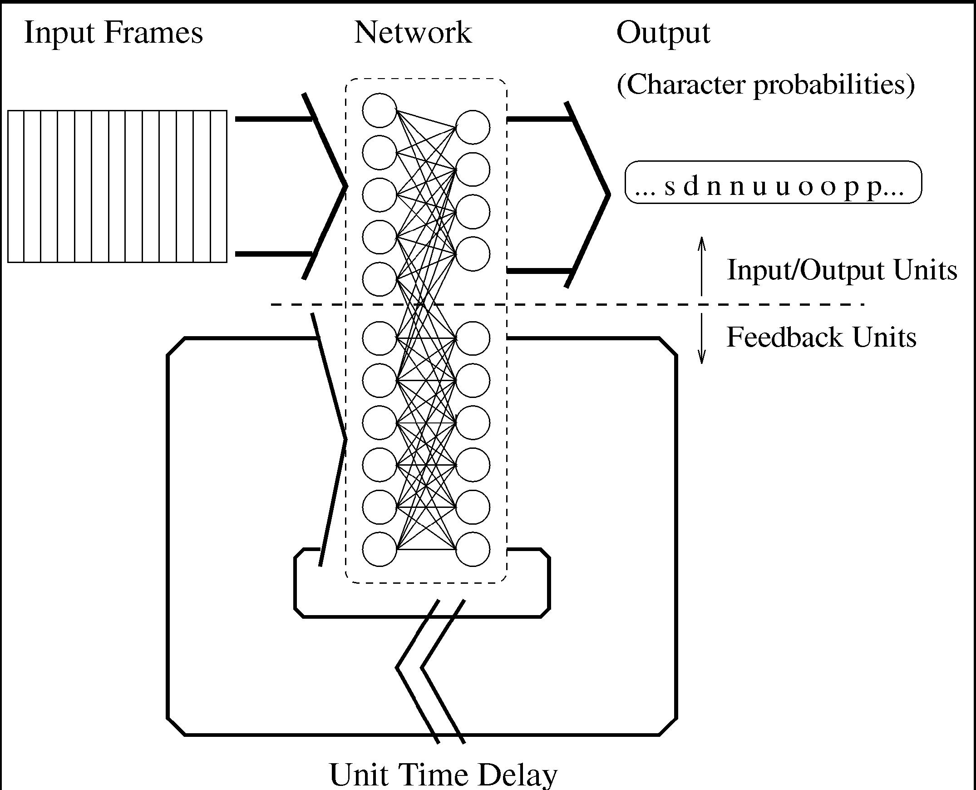

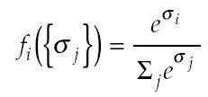
Recurrent Network
The feedback units have a standard sigmoid activation function
Character outputs have a “softmax” activation function
A schematic of the recurrent error propagation network**
** An Off-Line Cursive Handwriting Recognition System
Andrew W. Senior, Member, IEEE, and Anthony J. Robinson, Member, IEEE
IEEE TRANSACTIONS ON PATTERN ANALYSIS AND MACHINE INTELLIGENCE, VOL. 20, NO. 3, MARCH 1998.
Notes:
If you want the outputs of a network to be interpretable as posterior probabilities for a categorical target variable, it is highly desirable for those outputs to lie between zero and one and to sum to one. The purpose of the softmax activation function is to enforce these constraints on the outputs.

Slide 53
Some parameters
Stopping Criteria: The stopping criterion is a heuristic based on the observation of validation word error rate over time.
Adding more feedback units to the network increases its capacity, but the error rate of the system is seen to fall as the number of feedback units increase. (Feedback units ranging from 80 to 160 were used in this example)

Slide 54
Training problems.. solutions
Training never completes because | Possible solution
1. The network topology is too simple to handle amount of training patterns you provide. You will have to create bigger network. | Add more nodes into middle layer or add more middle layers to the network.
2. The training patterns are not clear enough, not precise or are too complicated for the network to differentiate them. | As a solution you can clean the patterns or you can use different type of network /training algorithm.
3. Your training expectations are too high and/or not realistic. | Lower your expectations. The network could be never 100% "sure"

Slide 55
Advantages/Disadvantages
Output oriented model. No specific steps or approach for arriving to the conclusion.
Online training is possible, which allows to keep ‘teaching’ the network.
Training takes up a large amount of time and the network has to be trained for all possible inputs.
The network model to be chosen is not based on any fixed rule. Parameters like no. of Hidden Layers, perceptrons on each layer can be determined based on experience.

Slide 56
Effective Data Mining Using Neural Networks
VLDB'95 Proceedings, Springer, Singapore, 1995
Hongjun Lu, Rudy Setiono, Huan Liu
Department of Information Systems Computer Science
National University of Singapore
References:
http://citeseer.ist.psu.edu/cache/papers/cs/13788/http:zSzzSzwww.eng.auburn.eduzSzuserszSzwenchenzSzcoursezSzcomp714zSzarticlezSzlu.pdf/lu96effective.pdf
http://en.wikipedia.org/wiki/NeuralNetwork.html

Slide 57
Criticism of Neural Networks
Generating/articulating rules is a difficult problem
Learning time is usually long
Multiple passes over the training data

Slide 58
Neural Network based Data Mining
Three phases
  Network Construction and Training
  Network Pruning
  Rule Extraction

Slide 59
Network construction and training
    Construct and train a neural network
Network Pruning
    Aims at removing redundant links and units without increasing the classification error rate
    Small number of units and links are left in the network
Rule Extraction
    Extracts classification rules from the pruned network
    (a1 θ v1) ^ (a2 θ v2) ^ … (an θ vn) then Cj

Slide 60
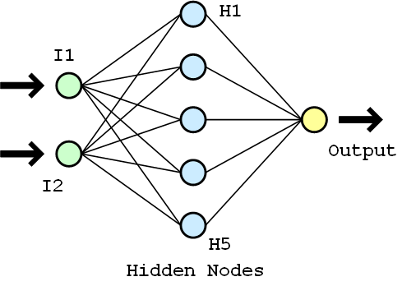
Rule Extraction Algorithm**
Input nodes, Hidden nodes, Output node
Activation values
**http://en.wikipedia.org/wiki/Image:Neuralnetwork.png

Slide 61
1. Enumerate hidden node activation values
E.g.
H = {0,0,1,1,0}
2.Generate rules that describe the network output in terms of the discretized hidden unit activation values
E.g.
(H1 = 0) ^ (H2 = 0) ^ (H3 = 1) ^ (H4 = 1) ^ (H5 = 0) then O

Slide 62
3. For each hidden unit, enumerate the input values that lead to them
E.g.
  For H1, I = {0,0}
  For H2, I = {0,1}
  For H3, I = {1,0}
  For H4, I = {1,1}
  For H5, I = {-1,-1}

Slide 63
4. Generate rules that describe the hidden unit activation value in terms of inputs
E.g.
  (I1 = 0) ^ (I2 = 0) then H1
  (I1 = 0) ^ (I2 = 1) then H2
  (I1 = 1) ^ (I2 = 0) then H3
  (I1 = 1) ^ (I2 = 1) then H4
  (I1 =-1) ^ (I2 =-1) then H5
5. Merge the two sets of rules to relate inputs and outputs

Slide 64
Future Enhancements
Training times still longer than those required by decision trees
Incremental training
Reduce training time and improve classification accuracy by feature selection

